Slide 1





PALMORIA GROUP
EMBRACING EQUITY:
Charting A Course For Palmoria’s Inclusive Future.
PRESENTED BY:
INTRA ANALYTICS

Slide 2


Slide 3


CONTENT
01
02
03
04
Meet The Team
Introduction
Problem Statement
Key Business Questions
05
06
07
08
Approach
Findings
Recommendations
Conclusion

Slide 4









MEET THE TEAM
Olabisi Jamiu J.
Daniella E. Atike
Esheti Stephen A.
Onyekwe Immaculeta C.
Olabode Kayode
Itohan Ugo
Muhammad Abdulhadi

Slide 5



INTRODUCTION
According to the World Economic Forum in 2018, it will take 108 years to close the global gender gap.

Slide 6



PROBLEM STATEMENT
Recent media coverage purports that Palmoria Group is heavily biased against females. Tabloids coverage poses a threat to the company’s expansion ambitions and Intra Analytics has been tasked to investigate the authenticity of
the media’s claim.

Slide 7






THE APPROACH
Analysis
Business Recommendation
Data Collection
The data was analyzed to gain insights and answer the key business question.
Two datasets were provided, “emp-data.csv” and “bonus-rules.xlsx”
Recommendations were made based on the insights generated from the data analysis
Business Understanding
Data Preparation
Visualization
The datasets were loaded to Power Query for cleaning and transformation
Strategic interactive reports were created to communicate the insights generated
The aims and objectives of the project were established

Slide 8




KEY BUSINESS QUESTIONS
Is there a gender disparity within the organization?
What are the ratings based on gender?
Is there a gender pay gap across the organization?
Does the company’s salary structure meet the manufacturing industry minimum wage regulation?

Slide 9
KEY BUSINESS QUESTIONS
What is the annual bonus pay to employees based on performance ratings?
What is the total amount(bonus inclusive) to be paid per region and company wide?
What is the total amount left to be paid to bridge the minimum wage requirement gap?

Slide 10
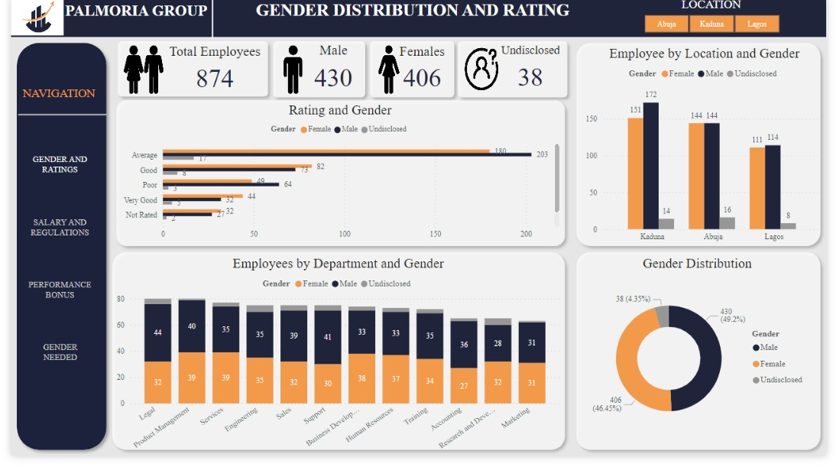
FINDINGS
Let’s get into
PowerBI to see our findings
A picture they say is worth a thousand words…

Slide 11

LIMITATIONS
The dataset provided was missing key elements such as employee grade, job roles, and leadership positions.
Company revenue was also not provided, making it difficult to advise accordingly for compliance in the increment of salaries.
The undisclosed gender affected the accuracy of the findings

Slide 12
BUSINESS RECOMMENDATIONS
Promote diversity in biased areas through mentorship and rewards
Utilize the model provided to ensure accuracy and balance in future hiring processes in specific departments and locations.
Review and adjust salary structure for wage standard compliance
Create feedback channels for ongoing workplace fairness
Require employees to choose a binary gender identity for analysis purposes

Slide 13


CONCLUSION
The insights derived from our findings show that the gender gap between male and female is minimal, therefore the news must be debunked.
However, the minimum wage requirement is a major issue that needs to be addressed with immediate effect to ensure compliance and employee satisfaction
49.2%
46.5%
MALES
FEMALES

Slide 14




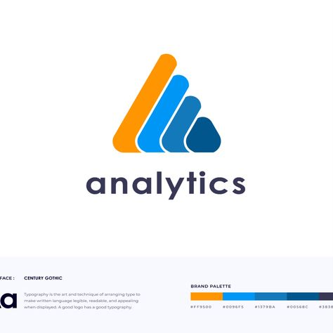


PALMORIA GROUP
THANK
YOU
Intra Analytics

